Slide 1
Burying the Lines
MSBA 502
Do underground power lines reduce outages at U.S. investor-owned utilities?
Andrew Massa
Jeremiah Cedano
Notes:
Open with the question: every utility customer loses power sometimes, and some lose far more than others. We wanted to know which investments actually buy reliability, and whether burying power lines is worth it.

Slide 2
Some utilities keep the lights on. Others leave customers in the dark for hours.
THE PROBLEM
108 min
929 min
median outage time per customer per year, normal days
worst utility-year in our data, more than 8 times the median
Question: which investments actually reduce outage minutes?
Notes:
Outage time is measured with SAIDI, the average minutes a customer is without power in a year. We use the version that excludes major event days, so it reflects how a utility runs on normal days. Median 108 minutes, worst 929 (Wheeling Power, West Virginia, 2022). That spread is what we try to explain.

Slide 3




Four groups decide or pay for reliability
WHO CARES
Regulators
Executives
Investors
Customers
State commissions approve utility spending and set reliability targets
Utility leaders choose where capital and maintenance dollars go
Spending decisions shape a utility’s costs and how regulators treat it
They live with the outages and pay for upgrades through their bills
Notes:
Investor-owned utilities are paid by their customers, and state regulators approve what they spend. So the question of which spending buys reliability matters to everyone on this slide.

Slide 4
Two federal sources, linked company by company
DATA
EIA Form 861
FERC Form 1
PUDL crosswalk
Outage minutes, customers, smart meters, circuits (per utility, state and year)
Dollars in overhead and underground lines, line maintenance spending (per company and year)
Matches each company’s FERC ID to its EIA ID so the two sources join
845
705
582
577
investor-owned rows with outage data, 2021–2025
IEEE-standard outage measure only
utilities that also file with FERC
final rows, 89 utilities, after removing tiny service areas
Notes:
All data came from PUDL, a nonprofit that publishes cleaned federal energy data. Each row is one utility in one state in one year. We kept only the IEEE version of SAIDI so every utility is measured the same way, and dropped Black Hills Power in Montana (30 to 47 customers), where one outage swings the numbers wildly.

Slide 5
One outcome, four things a utility can change
VARIABLES
Variable | What it measures | Source
SAIDI (outcome) | Outage minutes per customer per year, major event days excluded | EIA reliability
Underground share | Underground line dollars ÷ all line dollars | FERC plant
Maintenance per customer | Overhead + underground line maintenance $ ÷ company customers | FERC expenses
Smart meter share | Smart (AMI) meters ÷ all meters | EIA meters
Customers per circuit | Customers ÷ distribution circuits | EIA circuits
Notes:
Every X is a ratio, so big and small utilities can be compared fairly. Underground share uses FERC accounts 366 and 367 (underground conduit and cable) over 364 to 367 (adding poles and overhead wire). Maintenance uses accounts 593 and 594. Smart meters report outages automatically. Customers per circuit measures how many people lose power when one circuit fails.

Slide 6
Clean, merge, then regress
METHOD
1
2
3
4
Build
Model
Adjust
Stress-test
pandas: filter, group, pivot and merge 6 files into one table of ratios
statsmodels OLS: underground share alone, then all four variables
Standard errors clustered by utility, since FERC values repeat across a company’s states
Rerun with major event days included, then predict gains for the worst performers
Notes:
Clustering matters because FERC reports per company, so a company in three states contributes three rows with the same underground share. Clustering tells the model those rows are not independent, which keeps the p-values honest. Coefficients do not change.

Slide 7
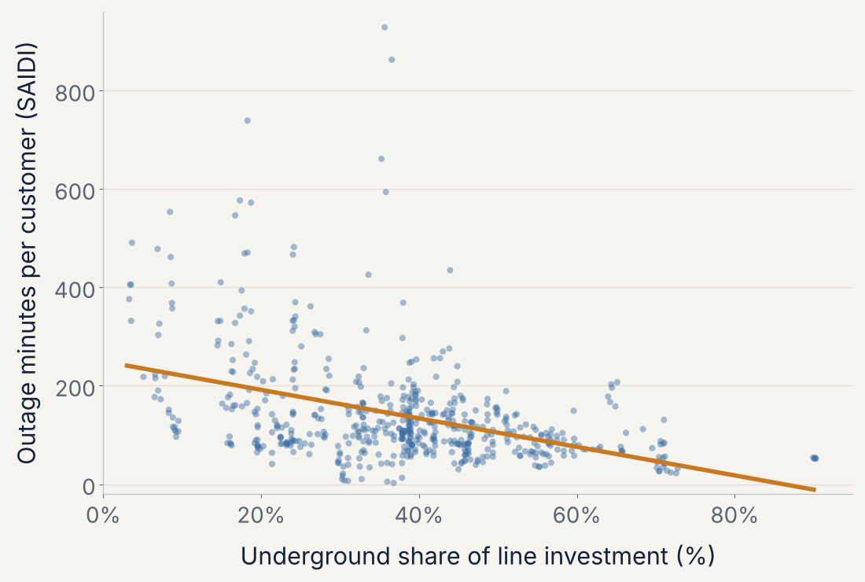
More underground lines, fewer outage minutes
−29 min
per customer per year for each +10 percentage points underground
R² = 0.17 · p < 0.001
Underground share alone explains 17% of the differences
Regression 1 · 577 utility-state-years, 2021–2025 · standard errors clustered by utility
Notes:
Each dot is one utility in one state in one year. The line keeps falling past 80 percent and dips below zero, which real outages cannot do; that is a limitation of a straight-line model.

Slide 8
Underground share holds up; smart meters and circuits don’t matter
ALL FOUR VARIABLES TOGETHER
Variable | Effect on outage minutes | p-value | Significant
Underground share | −22 per +10 points | 0.001 | Yes
Maintenance per customer | +6.5 per +$10 | 0.03 | Yes
Smart meter share | −0.4 per +10 points | 0.82 | No
Customers per circuit | +0.8 per +100 customers | 0.59 | No
More maintenance goes with more outages, most likely reverse causality: utilities with bad outages spend more on repairs.
Regression 2 · R² = 0.28 · 577 rows · standard errors clustered by utility
Notes:
Holding the other variables constant, underground share drops from minus 29 to minus 22 minutes per 10 points, because part of the simple effect was really maintenance. The model warns about a large condition number; that comes from variables on very different scales, not real multicollinearity (the largest correlation between X variables is 0.32).

Slide 9
On disaster days, underground lines matter four times more
THE TWIST
−22
−88
minutes per +10 points underground, normal days
minutes per +10 points, including hurricanes, ice storms and wildfires
Burying lines works like storm insurance: overhead lines go down in disasters, buried lines stay up.
Regression 2 rerun with SAIDI including major event days · both p ≤ 0.001 · R² falls to 0.06 because disasters are mostly random
Notes:
Same four variables, different outcome: outage minutes including major event days. The underground coefficient goes from minus 216 to minus 879. Median outage time doubles from 108 to 212 minutes once major events are included. Smart meters and customers per circuit become barely significant here, but with an R squared of 0.06 we do not build the story on them. Underground share is the only variable significant in every model.

Slide 10
Raising the worst 10 to average underground share saves 37 minutes on average
Utility (2025) | State | Outage min | Underground | Min saved
Monongahela Power | WV | 553 | 8% | 64
Appalachian Power | WV | 546 | 17% | 46
Wheeling Power | WV | 426 | 34% | 9
Entergy Mississippi | MS | 410 | 15% | 50
Kentucky Power | KY | 376 | 3% | 75
Alaska Electric Light & Power | AK | 369 | 38% | 0
Southwestern Electric Power | LA | 332 | 24% | 30
Appalachian Power | VA | 328 | 17% | 46
Southwestern Electric Power | TX | 312 | 24% | 30
Entergy Texas | TX | 305 | 27% | 22
Predicted with Regression 2, raising underground share to the 37.9% average where below it · normal-day minutes per customer per year
Notes:
Kentucky Power, at 3 percent underground, gains the most at 75 minutes. Alaska Electric gains nothing because it is already at the average, so its outages come from something else. Appalachian Power and Southwestern Electric Power appear twice because underground share is reported per company. These use the normal-day model; with major events included, savings would be about four times larger. They are predictions from a correlation, not guarantees.

Slide 11
What this analysis can’t tell us
LIMITATIONS
Correlation, not causation
Dollars, not miles
Utilities with more buried lines may also be newer or more urban
Underground line costs more per mile, so the dollar share overstates how much is buried
Company-level spending
Weather and straight lines
FERC values repeat across a company’s states; clustered errors account for it
Ordinary storms aren’t controlled for, and a linear model predicts below zero at the extremes
Notes:
Be upfront about these; they are the most likely Q and A topics. Weather is handled only by excluding major event days. We tested company size (log of customers) as a control and it changed nothing: p equal to 0.80, R squared unchanged.

Slide 12
Buried lines are the one investment tied to fewer outages in every model
TAKEAWAY AND NEXT STEPS
Next Steps
Cost per outage minute saved: undergrounding cost per mile against minutes gained
Payback period for burying lines at the worst-performing utilities
Add weather data by state to separate storms from utility performance
Notes:
Close on the one finding that held everywhere: underground share is significant in the simple model, the full model and the major events model. The open question for MSBA 503 is cost: burying lines is expensive, so the next step is cost per minute saved.

Slide 13
Contributions
APPENDIX
Team member | Contributed | Share
Andrew Massa | Cleaning and Merging Data, Power Point Slides | 100%, 50%
Jeremiah Cedano | Analysis of Data, Power Point Slides | 100%, 50%
Code contributions are stated and printed in both notebooks, as the rubric requires.
Notes:
Required by the rubric: each member's contribution to the slides, with percentages. Fill in the real split.

